Slide 1

Business Model Canvas: PhonePe
Presented By: Nilesh Kumar
Mapping and Exploring the Building Blocks of India's Premier Digital Payment and Financial Services Platform.

Slide 2
The 9 primary building blocks for our model:
Customer Segments
Value Proposition
Channels
Customer Relationship
Revenue Streams
Key Resources
Key Activities
Key Partners
Cost

Slide 3
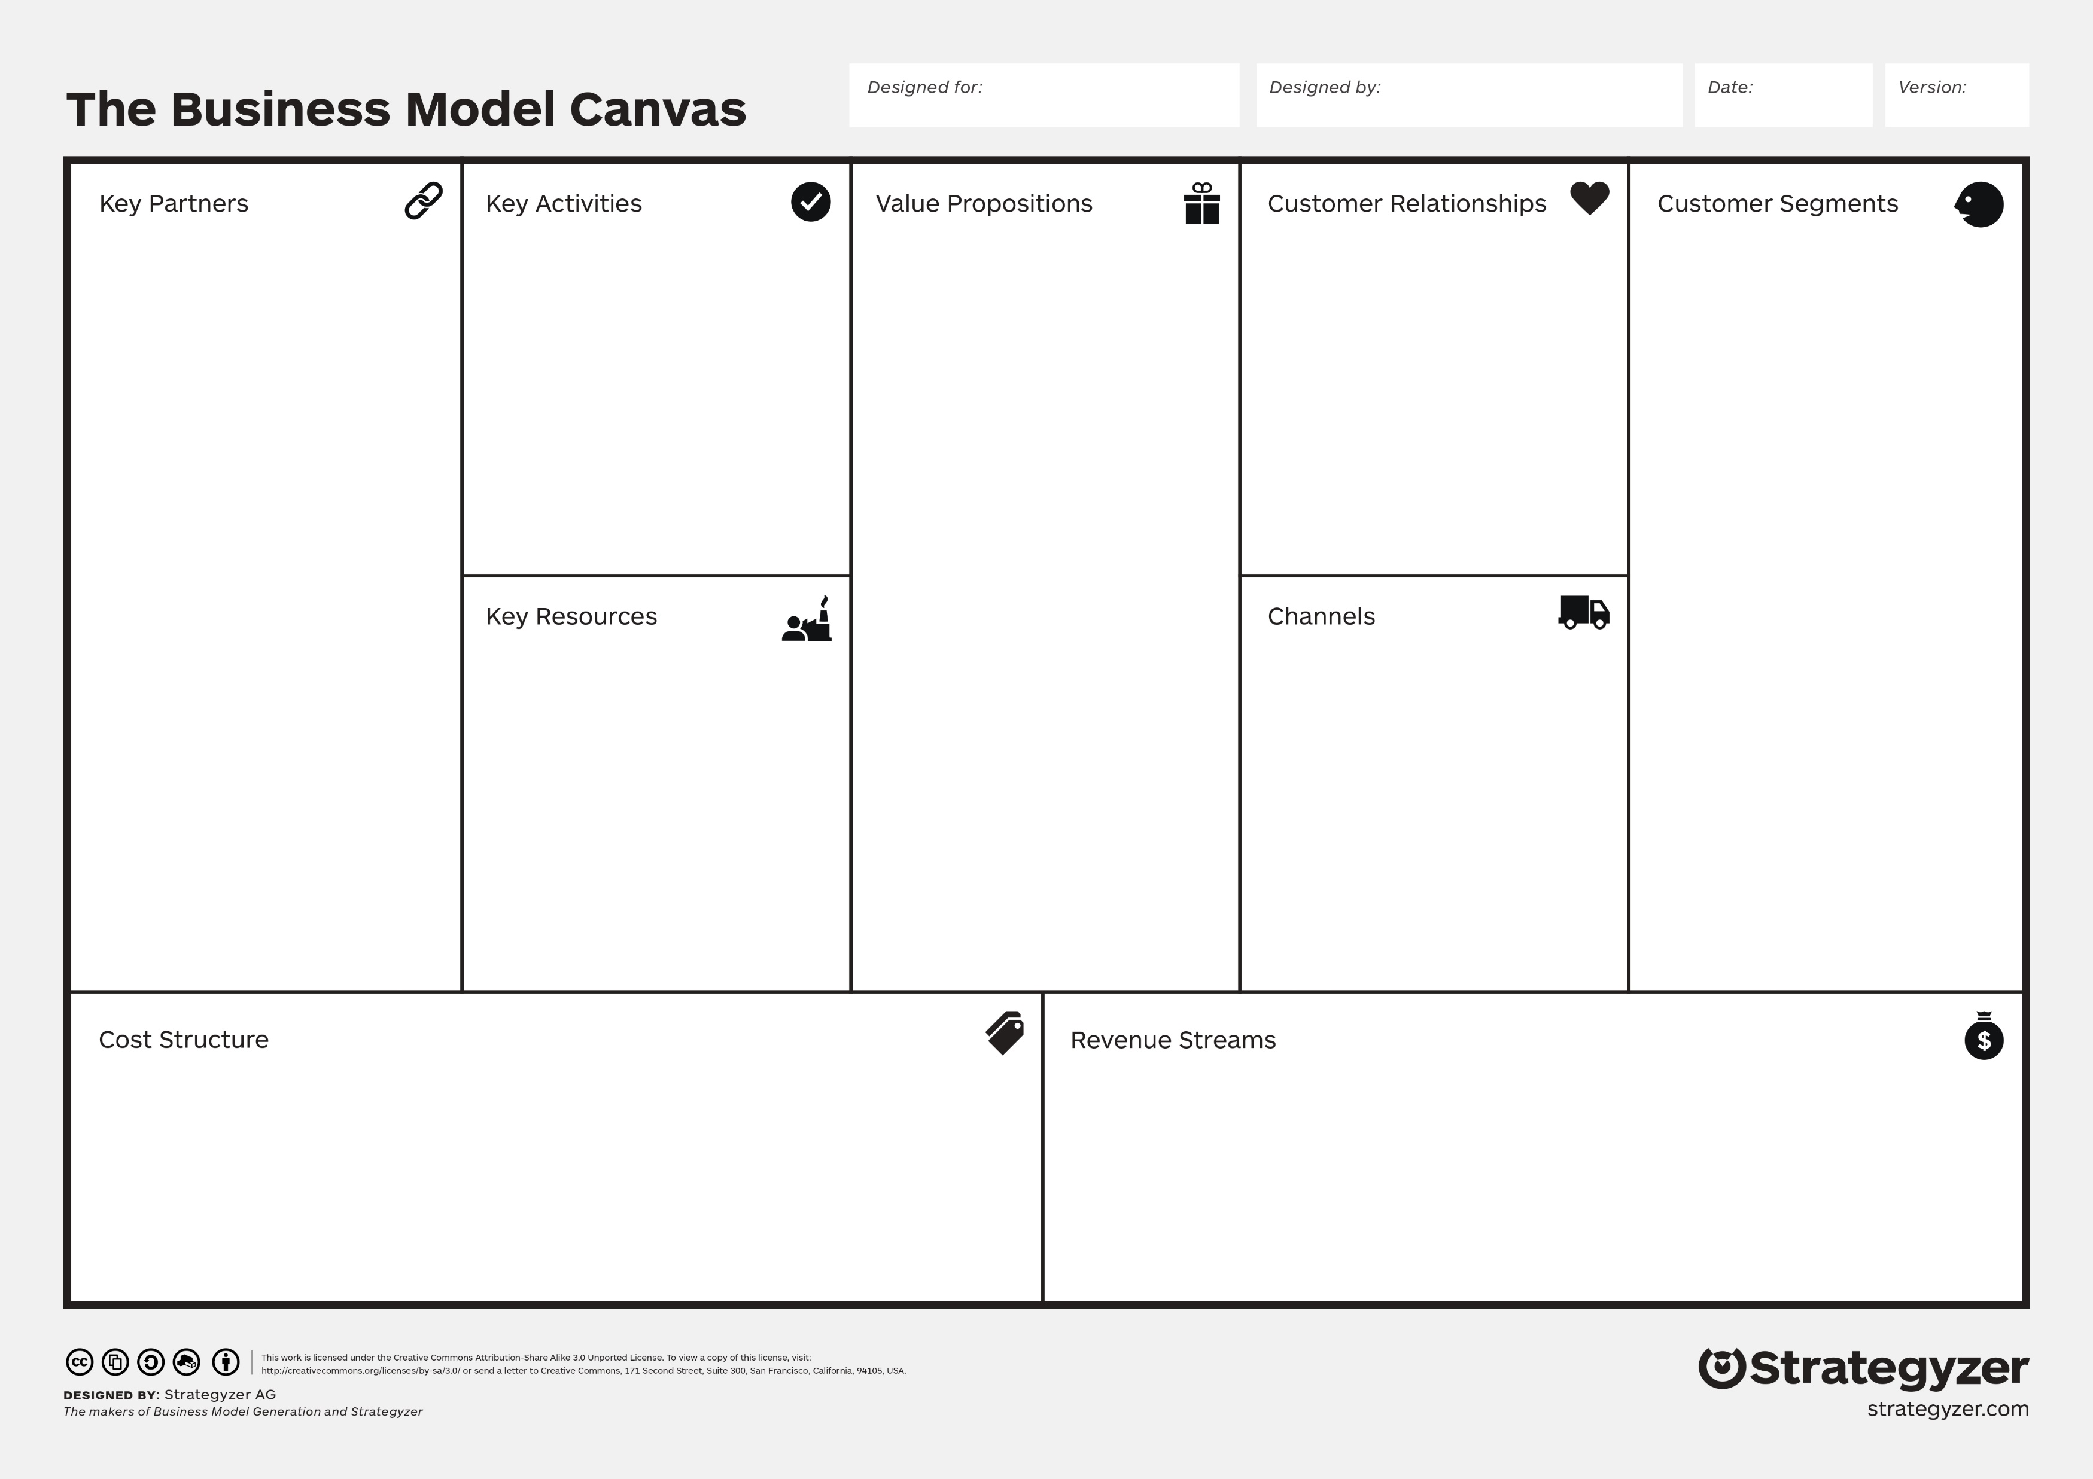
PhonePe
Nilesh kumar
App Development and Maintenance
Partnership Management
Security Enhancement
User Experience Improvement
Marketing and Promotion
Innovation and Research
Regulatory Compliance
Customer Support
Operational Efficiency
Self-Service
Responsive Support
Feedback Mechanism
Personalization
Educational Content
Engagement Campaigns
Data Privacy
Continuous Improvement
Banks and Financial Institutions
Merchants and Retailers
E-commerce Platforms
Utility Service Providers
Insurance Companies
Mutual Fund Providers
Government Bodies
Business Partners
Seamless Transactions
Convenience
Financial Flexibility
Enhanced Accessibility
Cutting-Edge Security
Innovative Features
Business Empowerment
Revolutionizing Transactions
Individual Consumers
Merchants and Retailers
Online Shoppers
Utility Bill Payers
Salaried Professionals
Freelancers and Gig Workers
Students and Young Adults
SMEs and Local Businesses
Rural and Underbanked Population
Corporate Clients
Technology Infrastructure
Talent Pool
Partnerships
User Base
Branding and Reputation
Financial Resources
Data Centers
APIs and Integrations
Mobile App
Online Platforms
UPI (Unified Payments Interface)
Partner Merchants
Cashback Partnerships
Financial Services
UPI AutoPay
Cross-Selling
Advertising
Technology Infrastructure
Research and Development
Marketing and Advertising
Partnership Costs
Employee Salaries
Security Measures
Operational Costs
Regulatory Compliance
Transaction Fees
Merchant Services
UPI Transactions
Bill Payments

Slide 4
1. Customer Segments:
Individual Consumers: PhonePe targets individuals who seek convenient digital payment solutions for various transactions, including bill payments, online shopping, and peer-to-peer transfers.
Merchants and Retailers: PhonePe caters to small and large businesses, offering them a seamless way to accept payments through QR codes, enabling cashless transactions.
Online Shoppers: PhonePe serves the growing online shopping market by providing a secure and swift payment method for purchases on e-commerce platforms.
Utility Bill Payers: PhonePe appeals to users who want to effortlessly settle utility bills, including electricity, water, and gas, all within the app.
Salaried Professionals: PhonePe offers a platform for salaried individuals to manage their finances, split bills, and send money to family and friends.
Freelancers and Gig Workers: PhonePe provides a way for freelancers and gig economy workers to receive payments from clients and manage their earnings.
Students and Young Adults: PhonePe caters to the tech-savvy younger generation, enabling them to handle their financial activities with ease.
SMEs and Local Businesses: PhonePe serves small and medium-sized enterprises by providing digital payment solutions that streamline their financial operations.
Rural and Underbanked Population: It's user-friendly interface makes digital transactions accessible to rural users and those with limited access to traditional banking services.

Slide 5
2. Value Proposition:
Seamless Transactions: Effortless, secure digital payments for bills, shopping, transfers.
Convenience: Anytime, anywhere transactions, enhancing user experience.
Financial Flexibility: Easy bill splitting, payment settlements for hassle-free finances.
Enhanced Accessibility: Empowering both rural and urban populations with cashless transactions.
Cutting-Edge Security: Robust measures for safeguarding sensitive data.
Innovative Features: QR code payments, utility bill settlements, rewards, enrich user experience.
Business Empowerment: Businesses benefit from user-friendly payment solutions.
Revolutionizing Transactions: Reducing reliance on physical currency, accelerating payments.

Slide 6
3. Channels:
Mobile App: PhonePe leverages its user-friendly mobile app as the primary channel for seamless digital transactions.
Online Platforms: Integrates with various online platforms, enabling users to make payments during online shopping.
UPI: Leverages the Unified Payments Interface (UPI) to facilitate direct bank-to-bank transactions.
Partner Merchants: Collaborates with merchants to offer PhonePe as a payment option, expanding its reach.

Slide 7
4. Customer Relationship:
Self-Service: PhonePe provides an intuitive mobile app for users to perform transactions independently.
Responsive Support: Offers customer support for resolving issues and answering queries promptly.
Feedback Mechanism: Collects user feedback to enhance user experience and address concerns.
Personalization: Tailors recommendations and offers based on user behavior and preferences.
Educational Content: Offers guides and tutorials to help users navigate the app effectively.
Engagement Campaigns: Runs campaigns and offers to keep users engaged and informed.
Data Privacy: Ensures strict data privacy and security, building trust with users.
Continuous Improvement: Iterates based on user feedback, enhancing the app's features and usability.

Slide 8
5. Revenue Streams:
Transaction Fees: Earns revenue through transaction fees charged to merchants for using the platform.
Merchant Services: Charges merchants for using PhonePe's payment gateway for online transactions.
UPI Transactions: Generates revenue from UPI transactions, especially peer-to-peer transfers.
Bill Payments: Charges convenience fees for utility bill payments made through the app.
Cashback Partnerships: Collaborates with businesses for cashback offers, earning commission on transactions.
Financial Services: Offers financial products like insurance and mutual funds, earning commissions.
UPI AutoPay: Charges convenience fees for automatic bill payments through UPI AutoPay.
Cross-Selling: Earns from promoting partner offers and products within the app.
Advertising: Generates revenue by allowing targeted ads on the platform.

Slide 9
6. Key Resources:
Technology Infrastructure: Advanced IT systems and servers to ensure smooth app functionality.
Talent Pool: Skilled developers, designers, and experts driving innovation and improvements.
Partnerships: Collaborations with banks, merchants, and service providers for seamless integration.
User Base: A large and diverse user base contributing to the platform's growth.
Branding and Reputation: Strong brand identity and positive customer perception.
Financial Resources: Capital investments for development, marketing, and expansion.
Data Centers: Secure and reliable data centers to safeguard user information.
APIs and Integrations: Integration with third-party services to enhance functionality.

Slide 10
7. Key Activities:
App Development and Maintenance: Continuous enhancement and bug fixing to ensure app performance.
Partnership Management: Collaborating with banks, merchants, and service providers for seamless operations.
Security Enhancement: Implementing robust security measures to protect user data and transactions.
User Experience Improvement: Regularly updating the app's user interface for better usability.
Marketing and Promotion: Launching campaigns and offers to attract and retain users.
Innovation and Research: Developing new features and exploring technology trends.
Regulatory Compliance: Ensuring adherence to financial regulations and data privacy laws.
Customer Support: Providing responsive assistance for user queries and concerns.
Operational Efficiency: Streamlining internal processes for effective service delivery.

Slide 11
8. Key Partners:
Banks and Financial Institutions: Partnerships with banks enable seamless fund transfers and transactions.
Merchants and Retailers: Collaboration to facilitate QR code payments and expand acceptance points.
E-commerce Platforms: Integration to offer convenient payment options during online shopping.
Utility Service Providers: Partnering for hassle-free bill payments within the app.
Insurance Companies: Collaborating to provide financial products and services to users.
Mutual Fund Providers: Integration for users to invest in mutual funds through the app.
Government Bodies: Partnerships for compliance with regulatory requirements.
Business Partners: Partnerships for co-branded offers and promotions.

Slide 12
9. Cost:
Technology Infrastructure: Investments in maintaining robust IT systems and servers.
Research and Development: Expenses for innovation and feature development.
Marketing and Advertising: Costs associated with promoting the app and offers.
Partnership Costs: Fees for collaborating with banks, merchants, and service providers.
Employee Salaries: Expenses for hiring and retaining skilled professionals.
Security Measures: Investments in ensuring user data privacy and protection.
Operational Costs: Expenses for day-to-day operations and maintenance.
Regulatory Compliance: Costs associated with adhering to financial regulations.

Slide 13
Conclusion:
In summary, the Business Model Canvas of PhonePe reveals how their smart strategies, technology, and focus on customers have made them a leader in the digital payment field. They've made it easy for users to handle their finances securely, offering various services that cater to many different people. By using new ideas and forming strong partnerships, PhonePe has changed how we handle transactions, making things better for everyone. Their journey shows that when we combine what people want, technology, and smart partnerships, we can create something that benefits both individuals and businesses. As PhonePe keeps growing and adapting, their canvas reflects the amazing journey that's made them a standout in modern financial services.

